Slide 1

Tech in Action Hacking4Humanity 2020
Charitable
Amber Torrise

Slide 2
Charitable: Overview
Briefly summarize your project. What disinformation issue does it solve or what need does it meet? What are its key features?
If you're going to donate to an organization, you want to make sure your money is going to the right places. The Charitable Google Chrome Extension provides a quick and easy overview of a nonprofit organization’s (NPO) charitable commitment history. Will your donation be sitting idly, going to the wrong places, or to going directly to the cause you signed up for? Charitable enables users to avoid bad-practice NPOs and to donate wisely.

Slide 3
Charitable: Marketing
Define the target market for your project (age, sex, geographic location, etc.)
The target market is likely United States adults over 25 that are settled and with enough income to spare for donations.
What makes your project unique? Why should people use your solution instead of another option that solves a disinformation issue?
Charitable makes an NPO’s financial details easier to find than a donate button. Currently, navigating financial information is a hassle and unlike the convenient experience offered by Charitable. You must be knowledgeable in finance to interpret a 990 (or to even know that the form exists!). Because of this barrier to entry, people tend to blindly donate and hope for the best. Charitable takes back some of the power from these NPOs by forcing their transparency. We shouldn't have to trust that our donations are actually in good hands, we should have the information to know that they are.

Slide 4
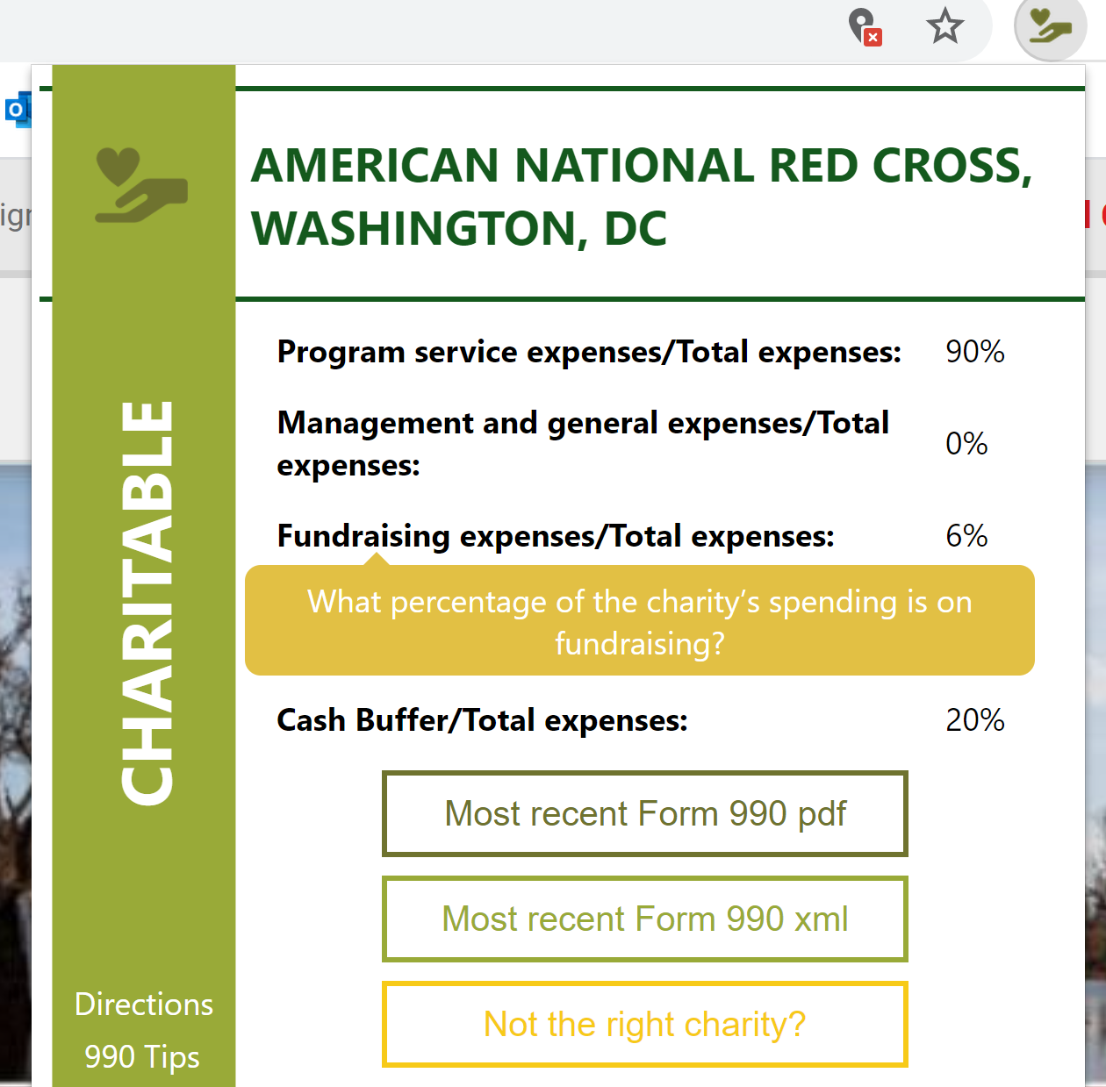
Charitable: Technology
What platform was your project built for and why?
The web! Google chrome extensions are extremely quick and easy to utilize. Because of this accessibility, it only takes Charitable one second to evaluate the financial health and charitable contribution of an NPO.
What programming language did you use to build your project?
I made my project with JavaScript, HTML, and CSS while utilizing ProRepublica’s nonprofit explorer. All I had to do was deploy my project into the chrome store where things like running and housing the scripts are already taken care of.

Slide 5
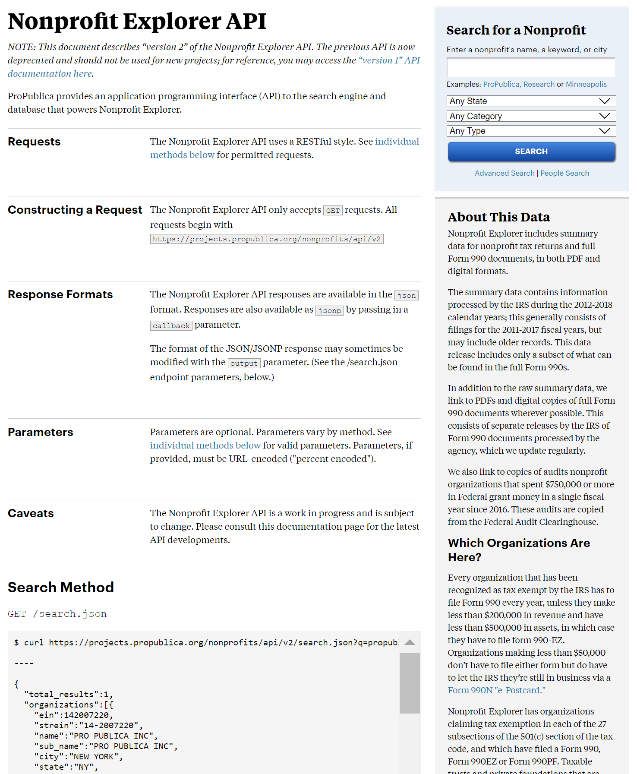
Charitable: Technology
What technologies does your project take advantage of?
My project utilizes ProRepublica’s Nonprofit Explorer API for tax-exempt organizations as a data source.

Slide 6
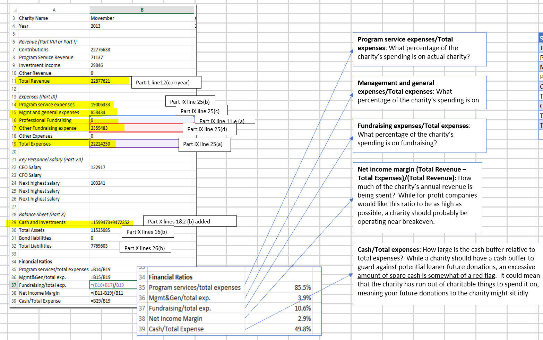
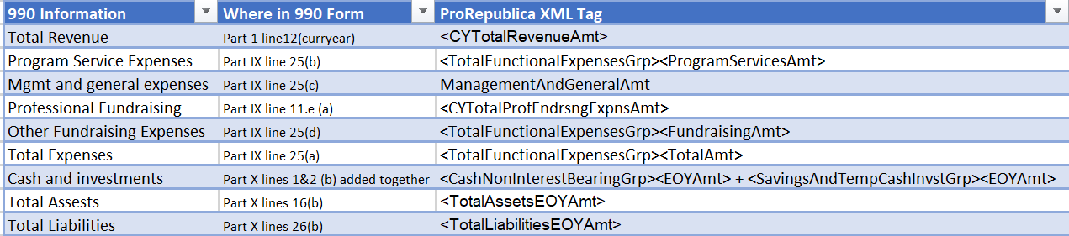

Charitable: Technology
Seen here is the work done to leverage XML links provided by prorepublica.
XML tags are made sense of when matched to IRS 990 data entries.
This enabled me to web-scrape for financial data.

Slide 7
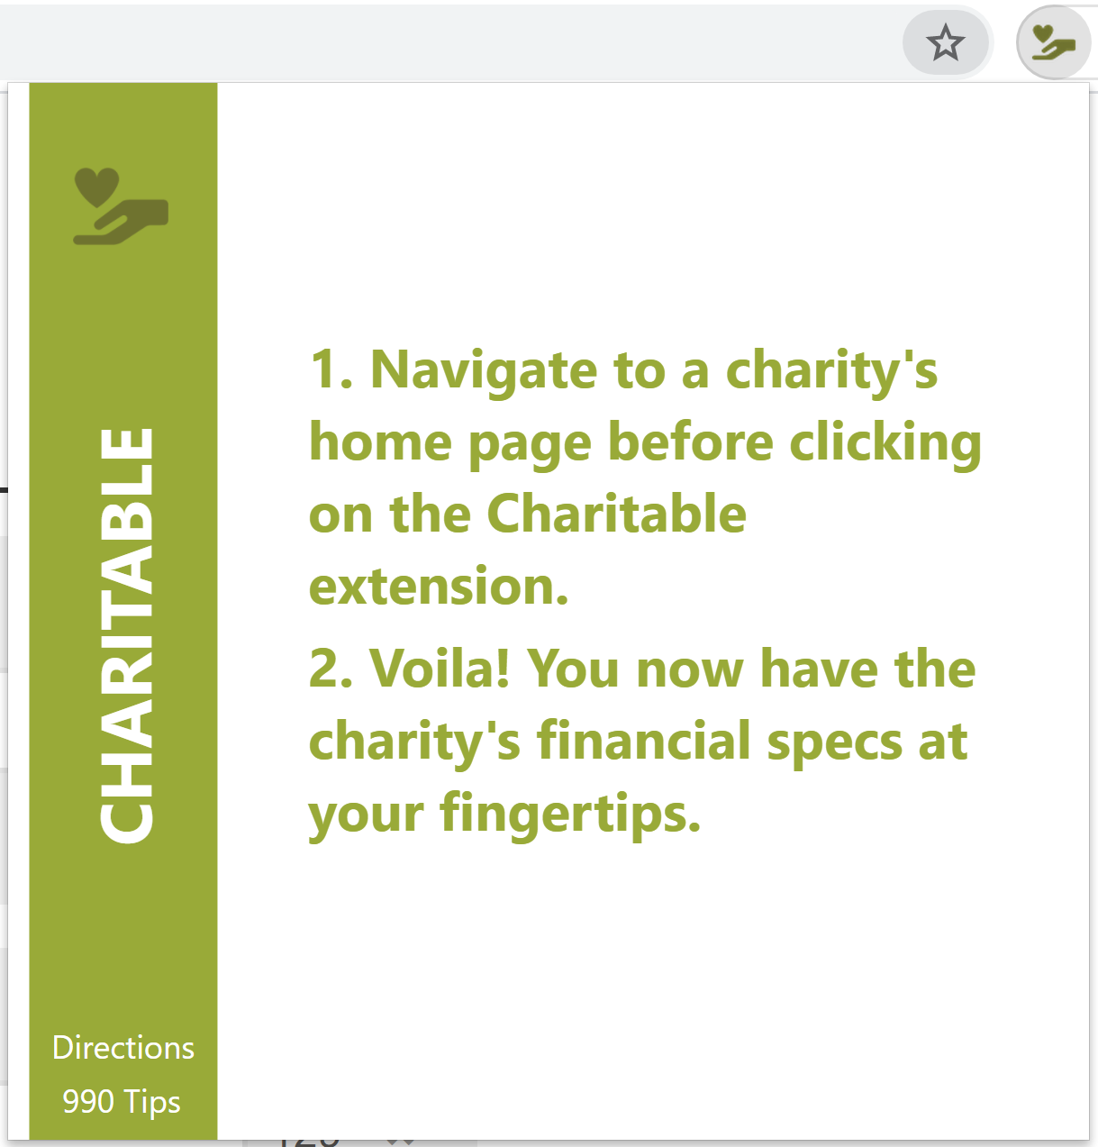
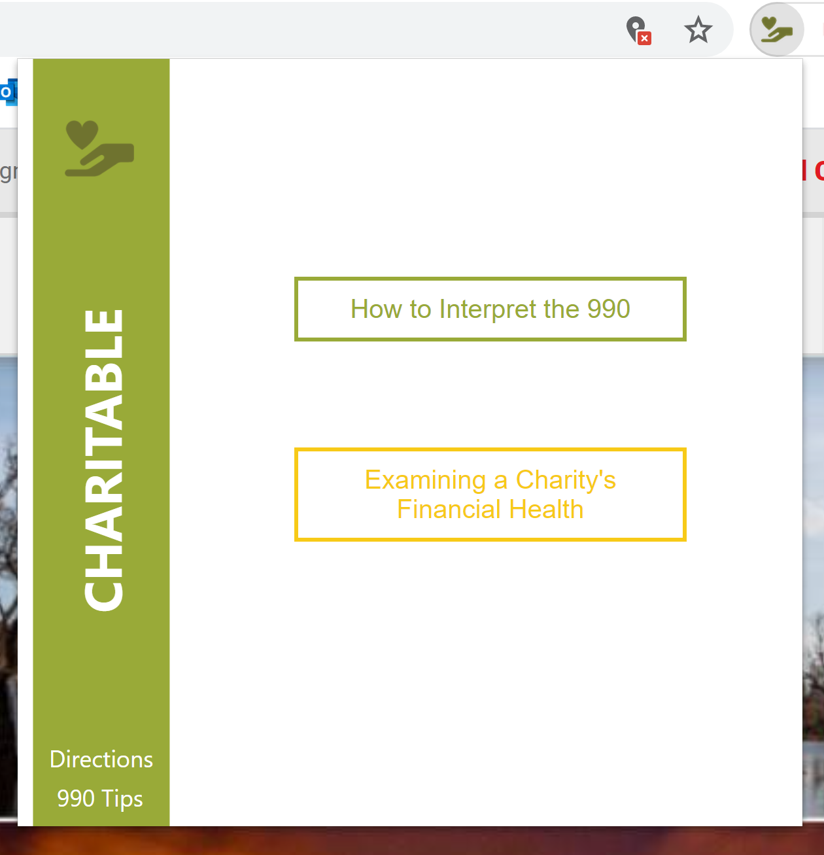
Charitable: User Experience
What kind of training, if any, will users need to utilize your project to the fullest?
To get started with the extension, users must be aware that the extension only reliably works when navigating to the homepage of the charity in question.
A large appeal to this project is the increased financial transparency that Charitable offers. One click of a button provides some metrics on the NPO as well as its most recent IRS 990 form that the user can inspect thoroughly and at their own pace. If the user is not a financial wizard, there are suggested links that aid in 990 interpretation.

Slide 8
Charitable: Additional Information (optional)
Anything else you want to communicate to judges?
I’ve made two different presentations:
Short (~4 mins)
In depth

